Slide 1
UNIT
DAY 6
01
BE THE COMPUTER
GAMES OF LOGIC
AGENDA
REMINDERS
Put your phones into The Holding Cell
Computers stay shut until I say - you need them twice today, and not yet
Warm Up Question
The Mailroom
The Instruction Set
Fetch, Decode, Execute
Trace Program A
LMC Simulator
Sabotage

Slide 2

THE WARM UP QUESTION
A computer does exactly what you tell it, in exactly the order you tell it
So how does it know what to do next?

Slide 3
THE WARM UP ANSWER
It keeps a number. Just one. The address of the next instruction
  Add one to that number and you have moved on. Overwrite it and you have jumped
That is the whole trick. There is no magic layer underneath
Today you are the thing that reads it

Slide 4
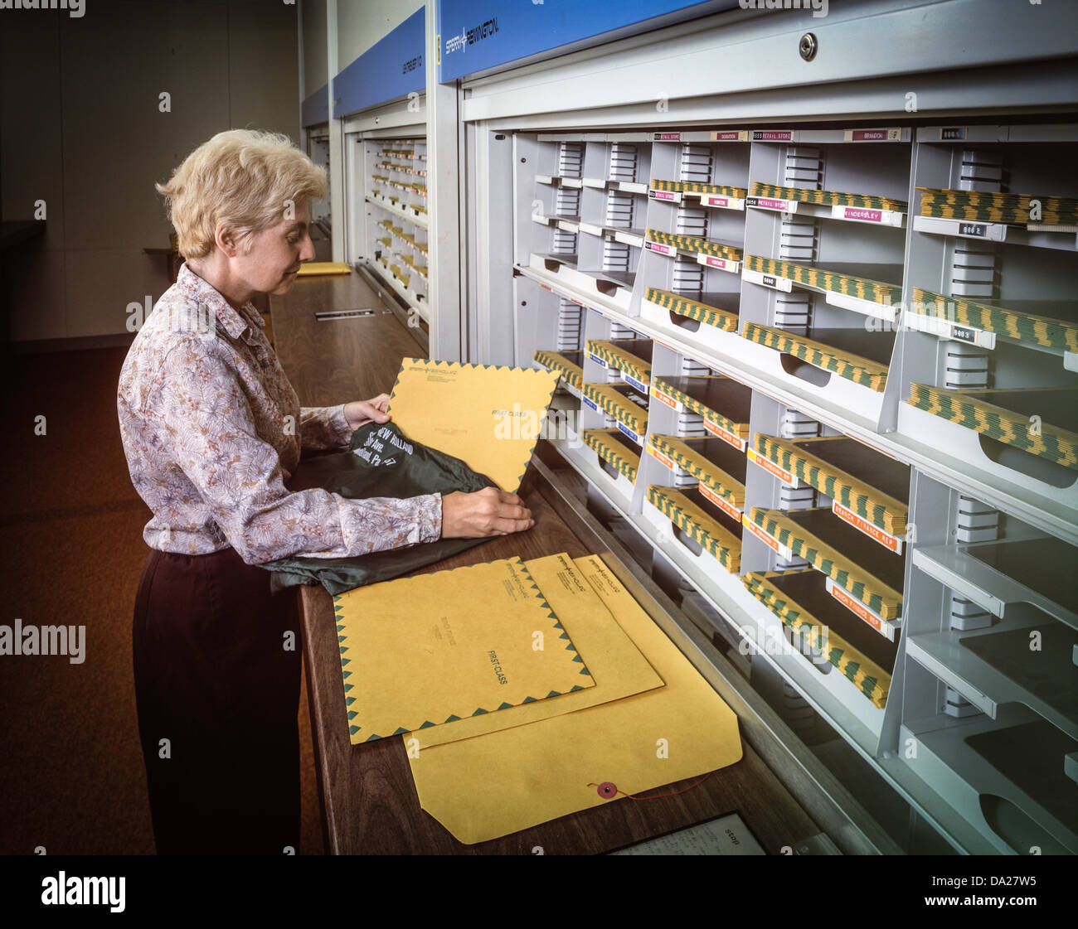
THE MAILROOM
Forget the computer. Picture a mailroom with one very person in it
He cannot think, plan, or remember anything between jobs
  He can read a slip of paper, do one arithmetic step, and put a number down
That is a CPU.

Slide 5

THE MAILROOM: MAILBOXES
100 mailboxes, numbered 00 to 99
Each one holds a 3-digit number
  That number might be data. It might be an instruction
  The mailbox has no idea which.

Slide 6
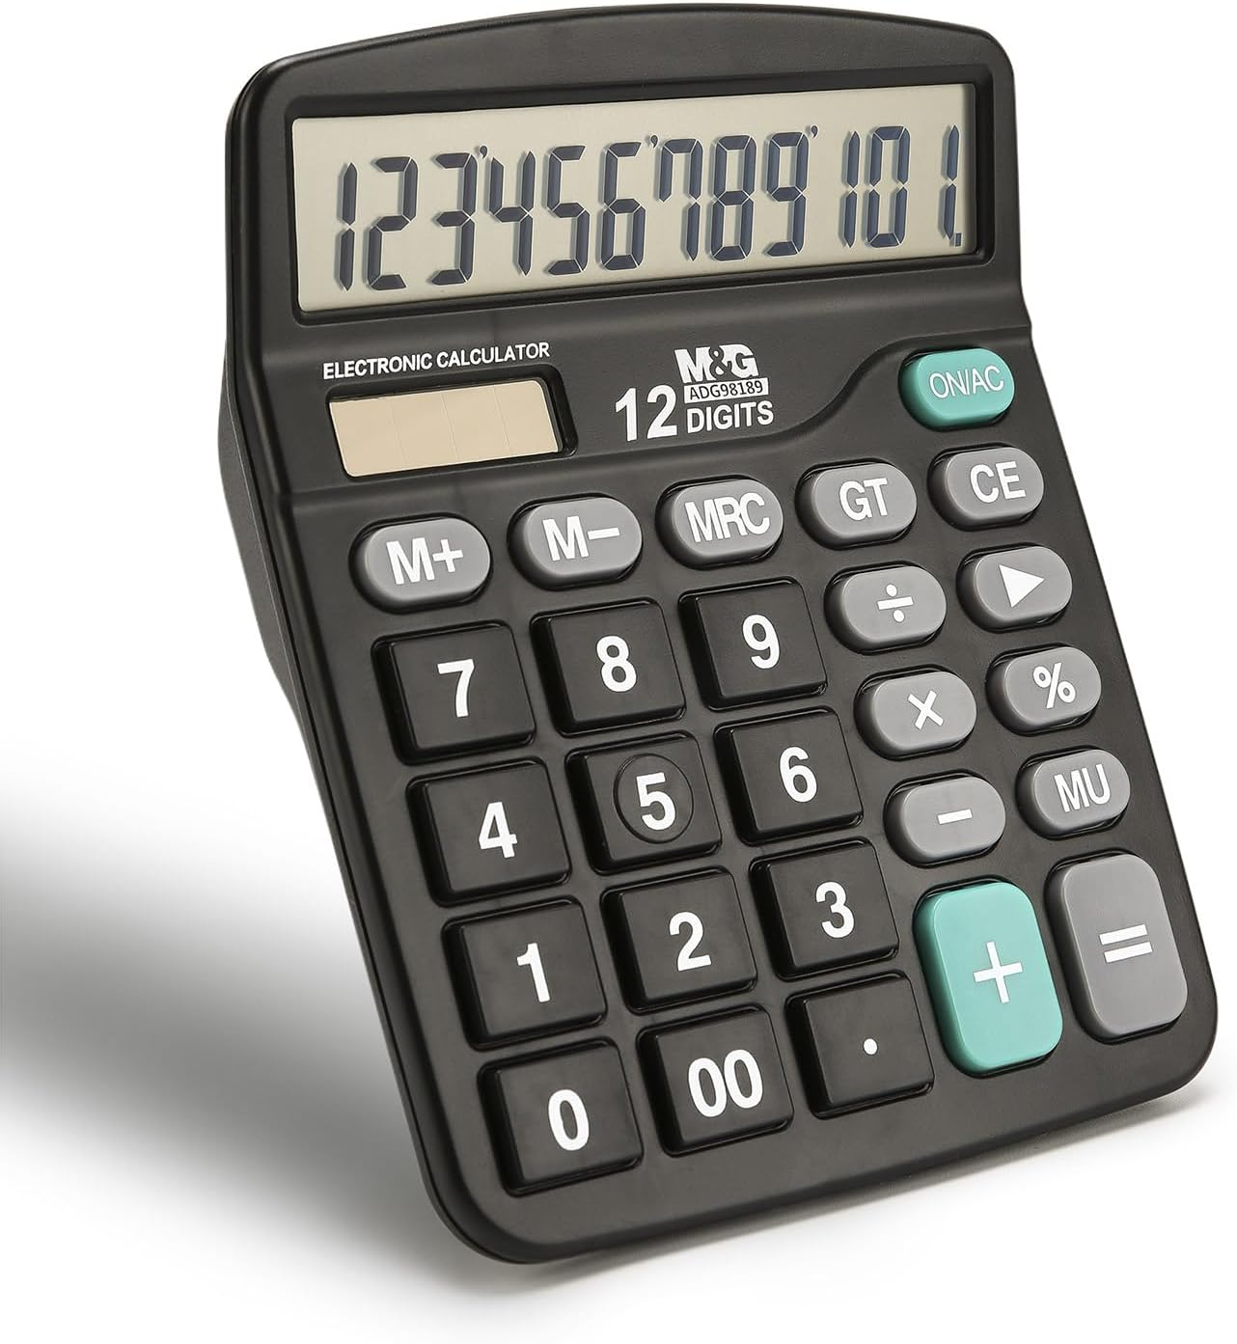
THE MAILROOM: THE CALCULATOR
One calculator, and it shows one number at a time
In a computer, we call this the accumulator
Everything passes through it. Add, subtract, load, store - all of it lands here first
  One number. Not two. This is why programs are longer than you expect

Slide 7
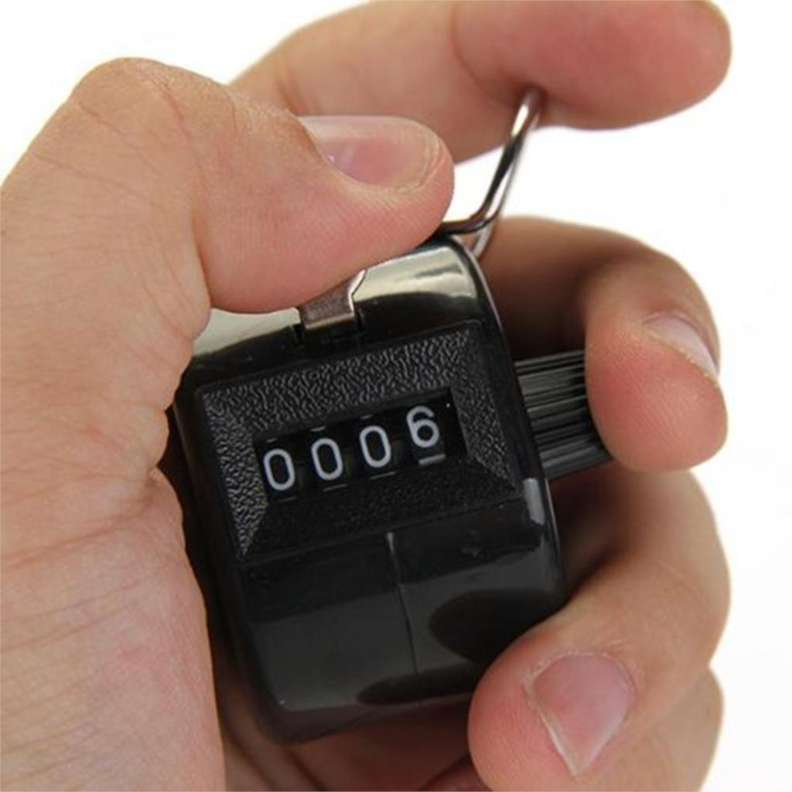
THE MAILROOM: THE COUNTER
One counter on the wall, holding a mailbox number
In a CPU, this is the program counter
It says: this is the mailbox I read next
  Nothing else decides the order

Slide 8
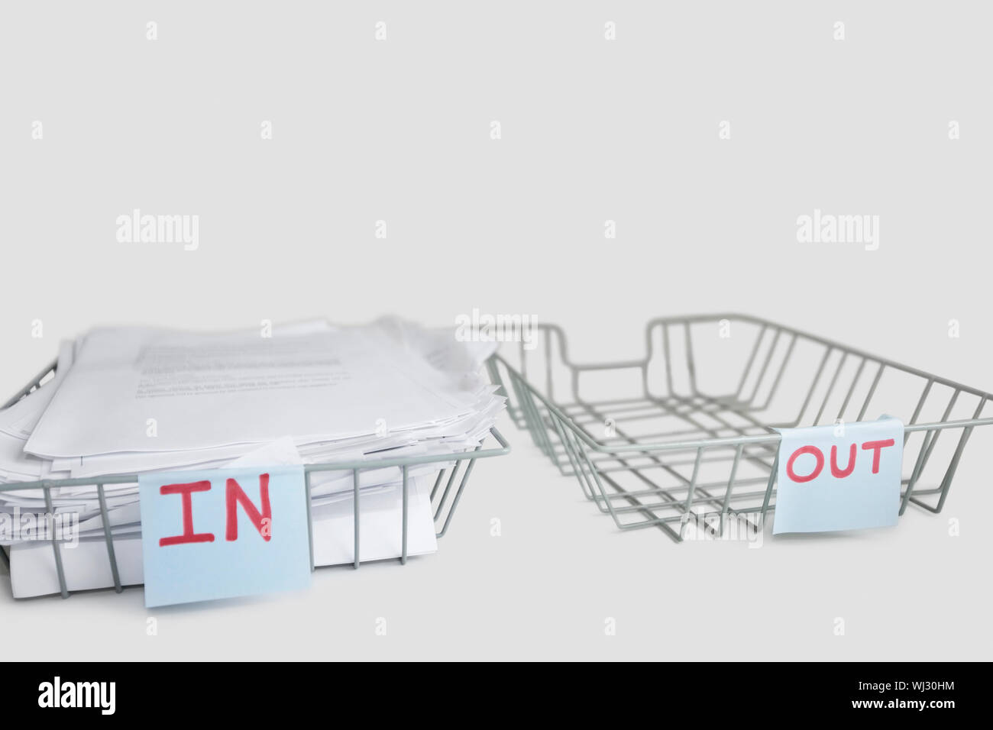
THE MAILROOM: THE TRAYS
An in-tray: numbers arrive from outside
An out-tray: numbers leave to outside
That is your input and your output, and there is nothing else in the room
  Four things total: mailboxes, calculator, counter, trays, make sense?

Slide 9
THREE DIGITS
Every instruction is exactly three digits
The first digit is the opcode - what to do
  Short for operation code
The last two are the operand - which mailbox to do it to
  If the instruction is 107
    The opcode 1 represents ADD
    The 07 represents mailbox 7

Slide 10
THE INSTRUCTION SET
Three commands that talk to the outside world, and one that stops
CODE | NAME | WHAT IT DOES
901 | INP | Take a number from the in-tray into the calculator
902 | OUT | Copy the calculator into the out-tray
000 | HLT | Stops the program immediately. Do not pass go. Do not collect $200.

Slide 11
THE INSTRUCTION SET
Four opcodes that move numbers around and do the arithmetic
CODE | NAME | WHAT IT DOES
5xx | LDA xx | Load mailbox xx into the calculator
3xx | STA xx | Store the calculator into mailbox xx
1xx | ADD xx | Add mailbox xx to the calculator
2xx | SUB xx | Subtract mailbox xx from the calculator

Slide 12
THE INSTRUCTION SET
Three opcodes that change the counter - and these are the ones that make it a computer
CODE | NAME | WHAT IT DOES
6xx | BRA xx | Set the counter to xx. Always
7xx | BRZ xx | Set the counter to xx, but only if the calculator is 0
8xx | BRP xx | Set the counter to xx, but only if the calculator is 0 or more

Slide 13
THE INSTRUCTION SET
What do you think the names of these opcodes mean?
CODE | NAME | WHAT IT DOES
6xx | BRA xx | Set the counter to xx. Always
7xx | BRZ xx | Set the counter to xx, but only if the calculator is 0
8xx | BRP xx | Set the counter to xx, but only if the calculator is 0 or more

Slide 14
QUICK MATHS
Decode these. Opcode first, then the mailbox
  902 199 000 705 310
Then go the other way and give me the three digits for these
  LDA 20 SUB 21 BRP 02 OUT
→ LAB Q1 and Q2 - do them now
CODE | NAME | WHAT IT DOES
901 | INP | Take a number from the in-tray into the calculator
902 | OUT | Copy the calculator into the out-tray
000 | HLT | Stops the program immediately. Do not pass go. Do not collect $200.
5xx | LDA xx | Load mailbox xx into the calculator
3xx | STA xx | Store the calculator into mailbox xx
1xx | ADD xx | Add mailbox xx to the calculator
2xx | SUB xx | Subtract mailbox xx from the calculator
6xx | BRA xx | Set the counter to xx. Always
7xx | BRZ xx | Set the counter to xx, but only if the calculator is 0
8xx | BRP xx | Set the counter to xx, but only if the calculator is 0 or more

Slide 15
FETCH, DECODE, EXECUTE
The little man repeats three steps forever, until something halts him
FETCH - go and get the instruction
DECODE - work out what it means
EXECUTE - do it
  Then back to the top. Every computer you own is doing this right now, billions of times a second

Slide 16
FETCH
Read the counter to find out which mailbox to open
Open it and copy the three digits onto your slip of paper
Then add one to the counter
  He increments the counter during fetch, before he has done anything

Slide 17
DECODE
Look at the first digit of the slip. That tells you which job this is
Look at the last two. That tells you which mailbox to use
He does not need to understand the program, just this one slip
  9 is special: 901 and 902 use the last two digits as the job, not as an address
CODE | NAME | WHAT IT DOES
901 | INP | Take a number from the in-tray into the calculator
902 | OUT | Copy the calculator into the out-tray
000 | HLT | Stops the program immediately. Do not pass go. Do not collect $200.
5xx | LDA xx | Load mailbox xx into the calculator
3xx | STA xx | Store the calculator into mailbox xx
1xx | ADD xx | Add mailbox xx to the calculator
2xx | SUB xx | Subtract mailbox xx from the calculator
6xx | BRA xx | Set the counter to xx. Always
7xx | BRZ xx | Set the counter to xx, but only if the calculator is 0
8xx | BRP xx | Set the counter to xx, but only if the calculator is 0 or more

Slide 18
EXECUTE
Do the one thing the slip says
  Load, store, add, subtract, in, out, branch, or halt
Then throw the slip away and go back to FETCH
  He remembers nothing except what’s on the calculator and the counter

Slide 19
THE ORDER MATTERS
The counter went up during fetch. So by execute time it already points at the next instruction
Now look at what a branch does: it overwrites the counter
  The increment already happened, so the branch simply overrides this
That is how a loop is possible
  If he incremented after execute instead, every branch would land one mailbox late and nothing would work

Slide 20
PROGRAM A
Six instructions. Read it before I run it and tell me what you think it does
ADDR | CODE | INSTR | WHAT IT MEANS
00 | 901 | INP | First number into the calculator
01 | 310 | STA 10 | Park it in mailbox 10
02 | 901 | INP | Second number into the calculator
03 | 110 | ADD 10 | Add the parked one back on
04 | 902 | OUT | Put the answer in the out-tray
05 | 000 | HLT | Stop

Slide 21
PROGRAM A: TRACE IT
Inputs are 4 then 7. We fill this in together, one row per fetch
  The accumulator column is the one to watch. It only ever holds one number
→ LAB Q3 - fill in your copy as we go
PC | CODE | INSTR | ACC | OUT
00 | 901 | INP | 4
01 | 310 | STA 10 | 4
02 | 901 | INP | 7
03 | 110 | ADD 10 | ?
04 | 902 | OUT | ? | ?
05 | 000 | HLT

Slide 22
PROGRAM A: THE ANSWER
The calculator goes 4, then 4, then 7, then 11
Out-tray: 11
It adds two numbers. Six instructions, and one of them is just "stop"
  Notice mailbox 10 was only ever needed because the calculator holds one number

Slide 23
SIMULATOR: TYPE IT IN
On your laptops, go to peterhigginson.co.uk/lmc
Type Program A into mailboxes (RAM) 00 to 05, then hit run and feed it 4 and 7
  Ignore the Assembly Language Code box for now
  Watch the counter and the accumulator while it steps. That is your trace, animated
→ LAB Q4

Slide 24
SIMULATOR: NOW BREAK IT
Change the 902 at mailbox 04 into a 901 and run it again
What happens, and why does it happen?
  It is now asking the in-tray for a number instead of putting one in the out-tray
  The little man does not notice, complain, or stop. He never does.

Slide 25
PROGRAM B
Eight instructions this time, and two mailboxes holding data
ADDR | CODE | INSTR | WHAT IT MEANS
00 | 901 | INP | Get a number
01 | 320 | STA 20 | Park it in mailbox 20
02 | 520 | LDA 20 | Load it back
03 | 902 | OUT | Output it
04 | 221 | SUB 21 | Take away 1
05 | 320 | STA 20 | Park the new value
06 | 802 | BRP 02 | If 0 or more, go back to 02
07 | 000 | HLT | Stop
20 | 000 | data | The running value
21 | 001 | data | The constant 1

Slide 26
PROGRAM B: THE BACKWARDS JUMP
Mailbox 20 holds the running value. Mailbox 21 holds the constant 001
Everything up to 05 is ordinary. Then BRP 02 sends the counter backwards
  06 is at a higher address than 02, so the program repeats a section it has already run
That is a loop, and it is made of one instruction

Slide 27
PROGRAM B: TRACE IT
Type 3 in as your input. Trace it yourself and tell me the full out-tray
BRP jumps when the accumulator is zero or more - so watch what happens at 0
  It takes 23 fetches to finish. You do not need all 23 rows, just the outputs
→ LAB Q5, parts a to c

Slide 28
SABOTAGE
Flip to the back of your page. Program A is printed on it, working, all six instructions
Secretly change exactly one digit. Not one instruction - one digit
Swap sheets. Your partner traces it and has to find the digit you changed
  If they find it, they win.
  If your change made no difference at all, you lose too
→ LAB Q6, parts a to e

Slide 29
SABOTAGE: THE GOOD ONES
Changing 902 to 901 is obvious - nothing comes out at all
Changing ADD 10 to ADD 11 is nasty. It still outputs a number. The number is just wrong
And one change does nothing whatsoever
  Mailbox 10 gets overwritten by STA before ADD ever reads it, so whatever you preset it to is thrown away
  That one is part d, and it is the best question on the sheet

Slide 30
MECHANIC BANK
Go to your tab of the mechanic bank, entry #4. Two mechanics built on instruction execution
Not a mechanic: players take turns in order
  Every game does that. It is a turn structure, not a concept
Mechanic: you program your robot with four face-down cards, then it executes them blindly while the board changes underneath
Mechanic: you may sabotage one instruction in an opponent’s program, and they only find out by running it
  You just played that second one. It is on the back of your sheet

Slide 31
LAB GRADE
Your lab for today is ICA 1-5 - Be the Computer, and it is on the GitHub
Every question had class time. If you are behind, it is homework

Slide 32
CLOSING
Four things in the room: mailboxes, a calculator, a counter, two trays
Three steps: fetch, decode, execute
One number decides the order of everything, and any instruction is allowed to overwrite it
Next time:
  We stop learning concepts and start choosing one. The game design claim grid is revealed, and no two of you can build the same thing

